Slide 1

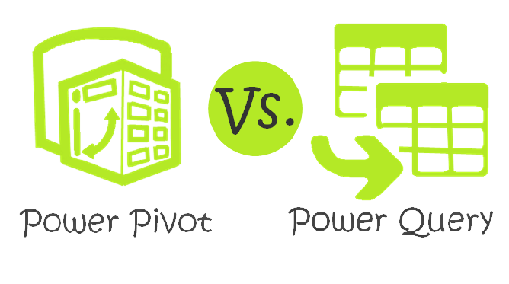

Why we need these excel Power tools
_____________________________________________________________________________________________
If you analyze a lot of data, these tools make your life a lot easier also if your data is from different sources, they will simplify the reporting process.
Power Pivot is like the engine, so without it, you can’t get any analysis done.
That means Power Pivot is a calculation engine for pivot tables. You can use Power Pivot to model complex data, set up relationships between tables, calculate things to be show in value field area of Pivot tables / pivot charts or visuals.
Power Query also called Get & Transform is the fuel for your engine – it’s how you get the data in. It allows you to clean up and prepare your data for the engine.
That means Power Query is a self-service ETL (Extract, Transform, Load) tool which runs as an Excel add-in. It allows users to pull data from various sources, manipulate said data into a form that suits their needs, and load it into Excel.

Slide 2
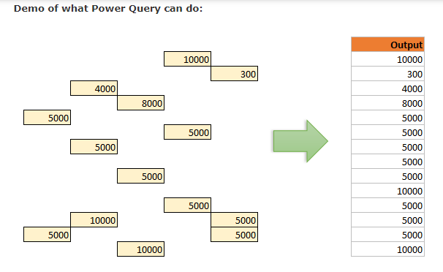

Slide 3
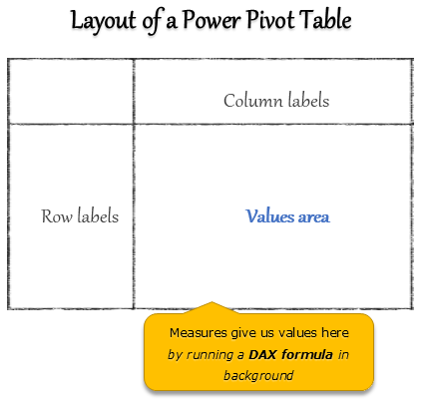
Think of Power Pivot as a
calculation layer between your
data and outputs.You can
tell Power Pivot how you want
your calculations done thru a
language called as DAX
and Power Pivot can give the
answers. It is an extremely fast
& scalable software.

Slide 4
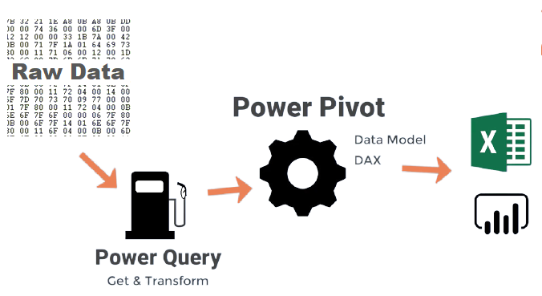

Slide 5
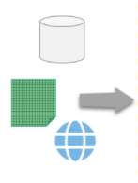
Power Query
Power BI
Connect
Fetch Data
Setup Filters
,Conditions
Merge/Combine
Add/Change Data
Reshape Data
Publish
Model Data
Setup Relationship
Calculate extra columns
Create measures
Setup KPIs
Make a Cube
Visualize Data
Analytics
Interactive DB
Publish and Share
Refresh and push changes
R and Python Integration
Power Pivot
Your Data
-{ M Language }-
-{ DAX Language}-
-{ Power BI includes Power
Query & Power Pivot}-

